Slide 2
Versions

Slide 3
Versions
Accpac.Advantage and Accpac.Advantage.Types remain at 6.7.0.0

Slide 4
Wizards

Slide 5
Wizards
Updated for 2020.2 release of the Sage 300 Web SDK
Solution Generation Wizard
Code Generation Wizard
Upgrade Wizard
Customization Wizards (Plugin and Standalone)
Language Resource Wizard (new in 2020.2)

Slide 6
Solution Wizard

Slide 7
Code Generation Wizard

Slide 8
Code Generation Wizard
Sage 300 has added the ability to change the color of the header section of the homepage
Changes made to the generated code to support this behavior

Slide 9
Upgrade Wizard

Slide 10
Upgrade Wizard
Sage 300 has added the ability to change the color of the header section of the homepage
Changes made to partner code to support this behavior

Slide 11
Language Resource Wizard

Slide 12
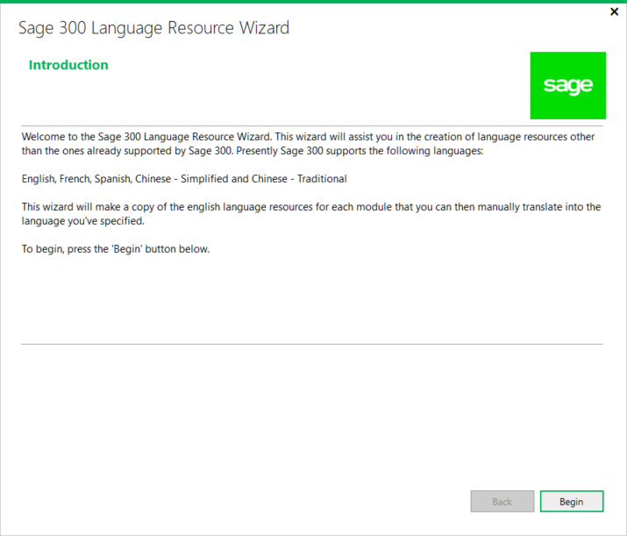
Language Resource Wizard
Visual Studio plugin compatible with Visual Studio 2017 and 2019
Generates language resources apart from the five supported languages in Sage 300
Allows Sage 300 resources to be modified
Partners responsible for translation
Partners responsible for delivering assemblies to customers
Open Source access
Does not localize desktop resources
Does not address modifications of a4w.ini to support additional languages

Slide 13
Samples

Slide 14
Samples
Sage 300 has added the ability to change the color of the header section of the homepage
Changes made to sample code to support this behavior

Slide 15
Utilities

Slide 16
Documentation

Slide 17
Documentation
Updated upgrade instructions for 2020.1 to 2020.2 in docs/upgrades
Updated Sage300SDK_Drilldown.docx in docs/development
New Sage300SDK_LanguageResourceWizard.docx in docs/wizards

Slide 18
Partner Enhancements and Issues

Slide 19
Partner Enhancements and Resolved Issues
Issue
In 2019.2, Partner Icons are in the ../Online/Web/External folder
In 2020 and 2020.1, a defect with the Multiple Session implementation was been discovered where the application will look in the ../Online/Web/OnPremise/External folder
Reason
The addition of the new segment in the URL was not accounted for in this area of the code
Resolution
Corrected in 2020.2 to account for the additional segment

Slide 20
Partner Enhancements and Resolved Issues
Issue
In 2020.1, partners could now participate in the drilldown framework from the web screens; however, if the DRILLDWNLK is not formatted in the business view, the Parameters string must be modified to known format to be compatible with the web and therefore requiring a change to the desktop as well
Reason
The drilldown framework in the web screens expects this format
Resolution
Added a new token, DRILLDWNLK, in the drilldown framework that will pass the unformatted Parameters string to the framework and therefore transferring responsibility of this unformatted string to the partner’s endpoint
Allows partners not to have to format the Parameters string in the business view and therefore allowing the desktop drilldown to continue to work without changes

Slide 21
Web API Enhancements and Issues

Slide 22
Patch

Slide 23
GitHub Repository
Open Source
https://github.com/SageNADev/Sage300-SDK
2020.1 is available in the “master” branch
2020.2 is available in the “develop” branch (in-progress)
Archives
2020.0 available in “release-2020.0”
2019.2 available in “release-2019.2”
2019.1 available in “release-2019.1”
2019.0 available in “release-2019.0”
2018.2 available in “release-2018.2”
2018.1 available in “release-2018.1”
2018.0 available in “release-2018”
2017.2 available in “release-2017.2”
2017.1 available in “release-2017.1”
2017.0 available in “release-2017”

Slide 24


Who needs to hear partner requests?
Sage 300 Product Manager!
Allocates capacity per release and sets roadmap for product
Contact him regarding functionality, documentation, tutorials, enhancements, etc. not in the SDK that should be there to better assist with efficient development practices
Architecture/Development capacity requests
We will advise, address and allocate resources within our capacity
Tracking requests on high, medium, low priority basis
The partner’s voice and feedback resounds the loudest!

Slide 25

GitHub Repository
Open Source
https://github.com/SageNADev/Sage300-SDK
2020 is available in the “master” branch
2020.1 is available in the “develop” branch (in-progress)
Archives
2019.2 available in “release-2091.2”
2019.1 available in “release-2019.1”
2019.0 available in “release-2019.0”
2018.2 available in “release-2018.2”
2018.1 available in “release-2018.1”
2018.0 available in “release-2018”
2017.2 available in “release-2017.2”
2017.1 available in “release-2017.1”
2017.0 available in “release-2017”

